Slide 1
AI IN HEALTHCARE DETECTION OF FETAL CONGENITAL HEART DEFECTS
Team - PIKA_PIKA

Slide 2
Team Detail
College- IIIT Bhubaneswar
Team Member 1 : Ashutosh Singh
Team Member 2 : Piyush Shukla
Team Member 3 : K Shreya
Team Member 4 : Akash Kumar

Slide 3
Problem Statement
DETECTION OF FETAL CONGENITAL HEART DEFECTS (CHD)
In theory over 90% of complex congenital heart disease is diagnosable.
Whereas in practice the fetal diagnosis rate for CHD is only 30-50%.
Main reason for this startling diagnosis gap is inadequate/uneven expertise in interpreting fetal cardiac images.
Due to diagnostic challenge presented by a small and fast-beating fetal heart.

Slide 4
Solution Proposed
We thought of constructing a model which would be able to locate heart and classify different views of fetal heart from a given temporal sequence/ video.
And a tool also which will bookmark all the predicted views of fetal anatomy in real time, hence reduced human reliance.

Slide 5
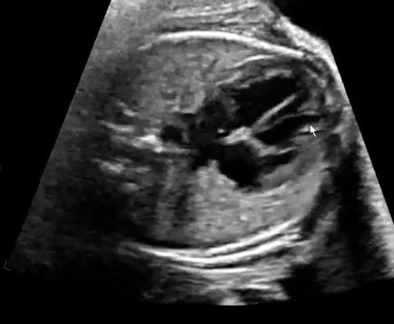
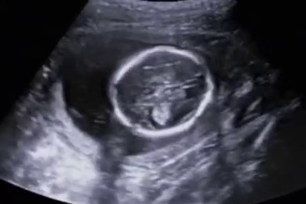
Data Sample
Heart Image
Non-Heart Image

Slide 6
Solution Approach
Fetal heart images data
Fetal non-heart images data
Data Acquisition
ML Model
(ResNet-50)
Feature Engineering
Data Cleaning
Model training
Algorithm selection
Hyper parameter tuning
Model Evaluation
Validation Graphs
Training iterations
Normalization
Regularization
Environment – Python 3.6
Python 3.6 Libraries - Keras, Tensorflow , Scikit learn , Pandas, Numpy, livelossplot
Detection of fetal congenital heart defects

Slide 7
Why Residual Networks (ResNet-50) ?
Deep convolution neural networks have led to a series of breakthroughs for image classification.
Hence there is a trend to go more deeper.
But as we go deeper there is a degradation problem causing accuracy to get saturated or decrease even.
One solution to this solution is Forward propagation of feature from previous layers directly as identity function (Residual propagation).
Hence Residual Propagation makes networks easier to optimize, and can gain accuracy from considerably increased depth.
Hence ResNet is used.

Slide 8
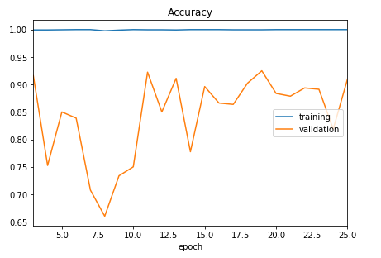
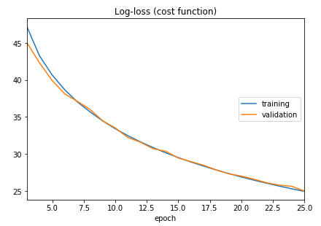
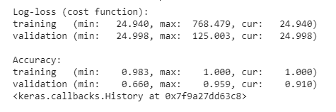
Results

Slide 9

Demo of Tool Prototype
Non-Heart
Heart

Slide 10
Business Model & Impact
Time taken for Fetal echocardiography is very long and overall accuracy of congenital heart defect detection is of 30-50 percent only causing significant morbidity and mortality after birth.
So with the proposed solution we intend to reduce the time required for fetal echocardiography by 60-70 percent and also increase the CHD defect detection rate.

Slide 11
References
AUTOMATED CHARACTERIZATION OF THE FETAL HEART IN ULTRASOUND IMAGESUSING FULLY CONVOLUTIONAL NEURAL NETWORK Vaanathi Sundaresana, Christopher P. Bridgea, Christos Ioannoub, J. Alison Noblea.
Early Prediction of Heart Diseases Using Data Mining Techniques Caribbean Journal of Science and Technology, Vol. 1, 208-217, 2013.
A. Krizhevsky, I. Sutskever, and G. Hinton. Imagenet classiﬁcation with deep convolutional neural networks. In NIPS, 2012.

